Slide 1
React Native
Writer : Kevin

Slide 2
Outline
CSS
Third Party
Environment Setting
Routes
UI on Device
Conclusion

Slide 3
Web and App 相同之處只有
語法
而且還掰咖

Slide 4
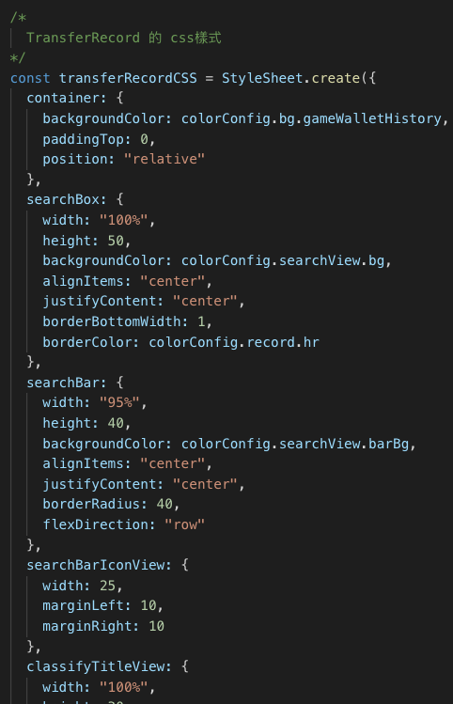
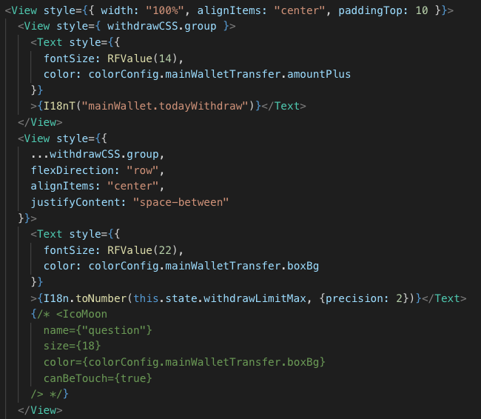
CSS

Slide 5
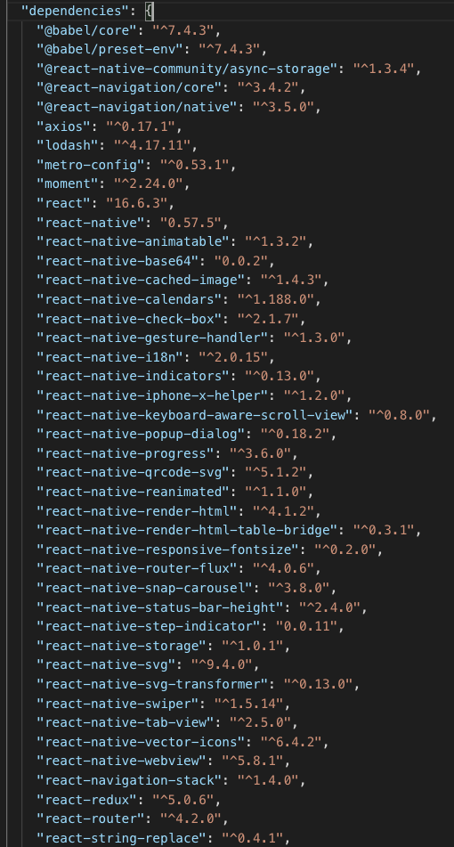
Third party

Slide 6
Environment Setting
Android
ios

Slide 7
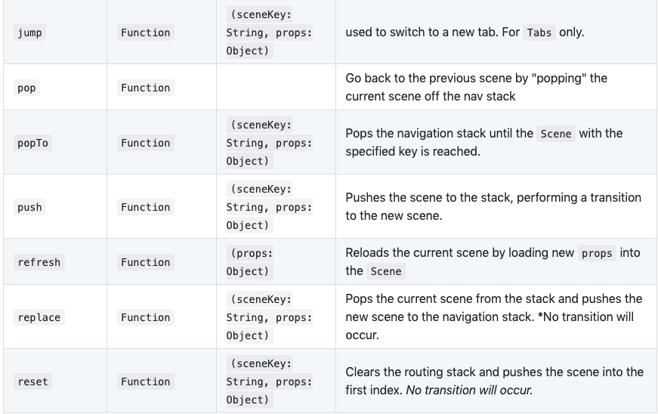
Routes (not SPA, is stack)

Slide 8
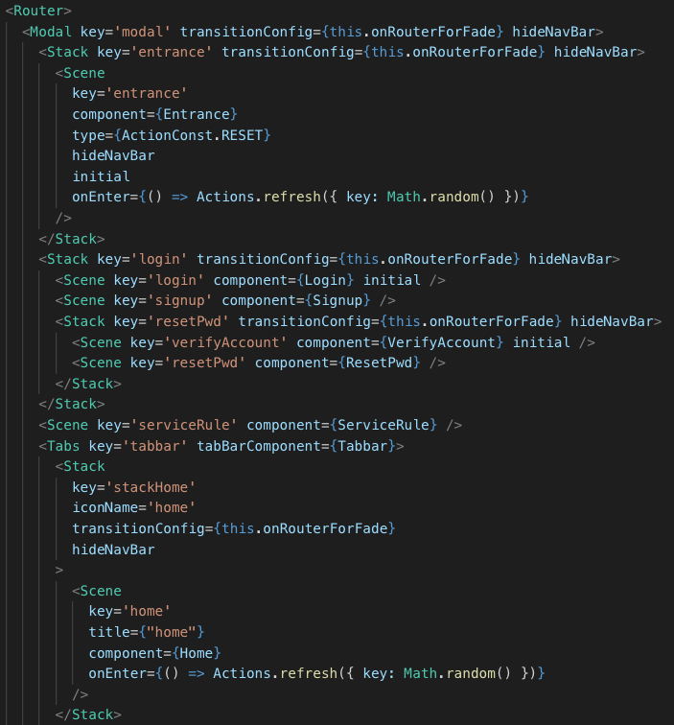
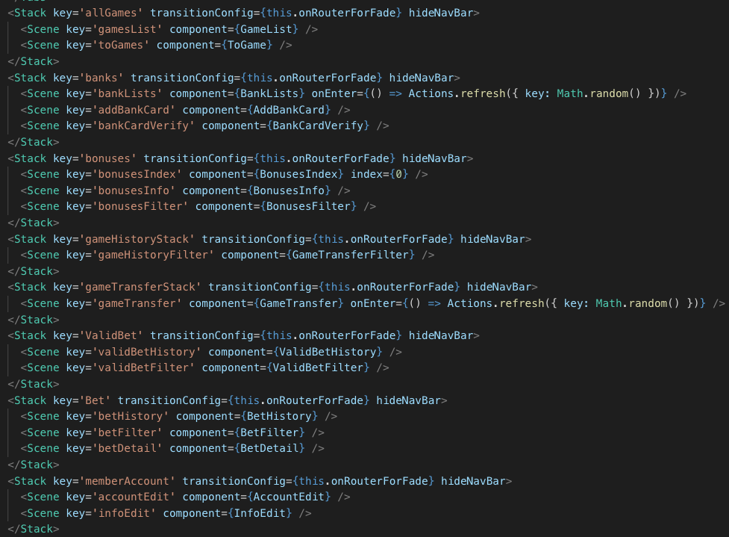
Routes

Slide 9
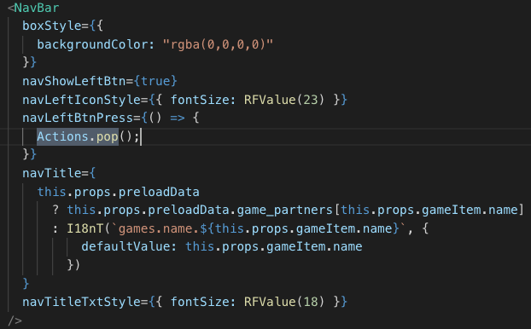
Routes

Slide 10
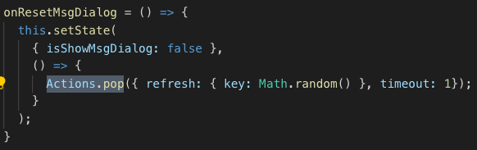
Routes

Slide 11

Routes

Slide 12
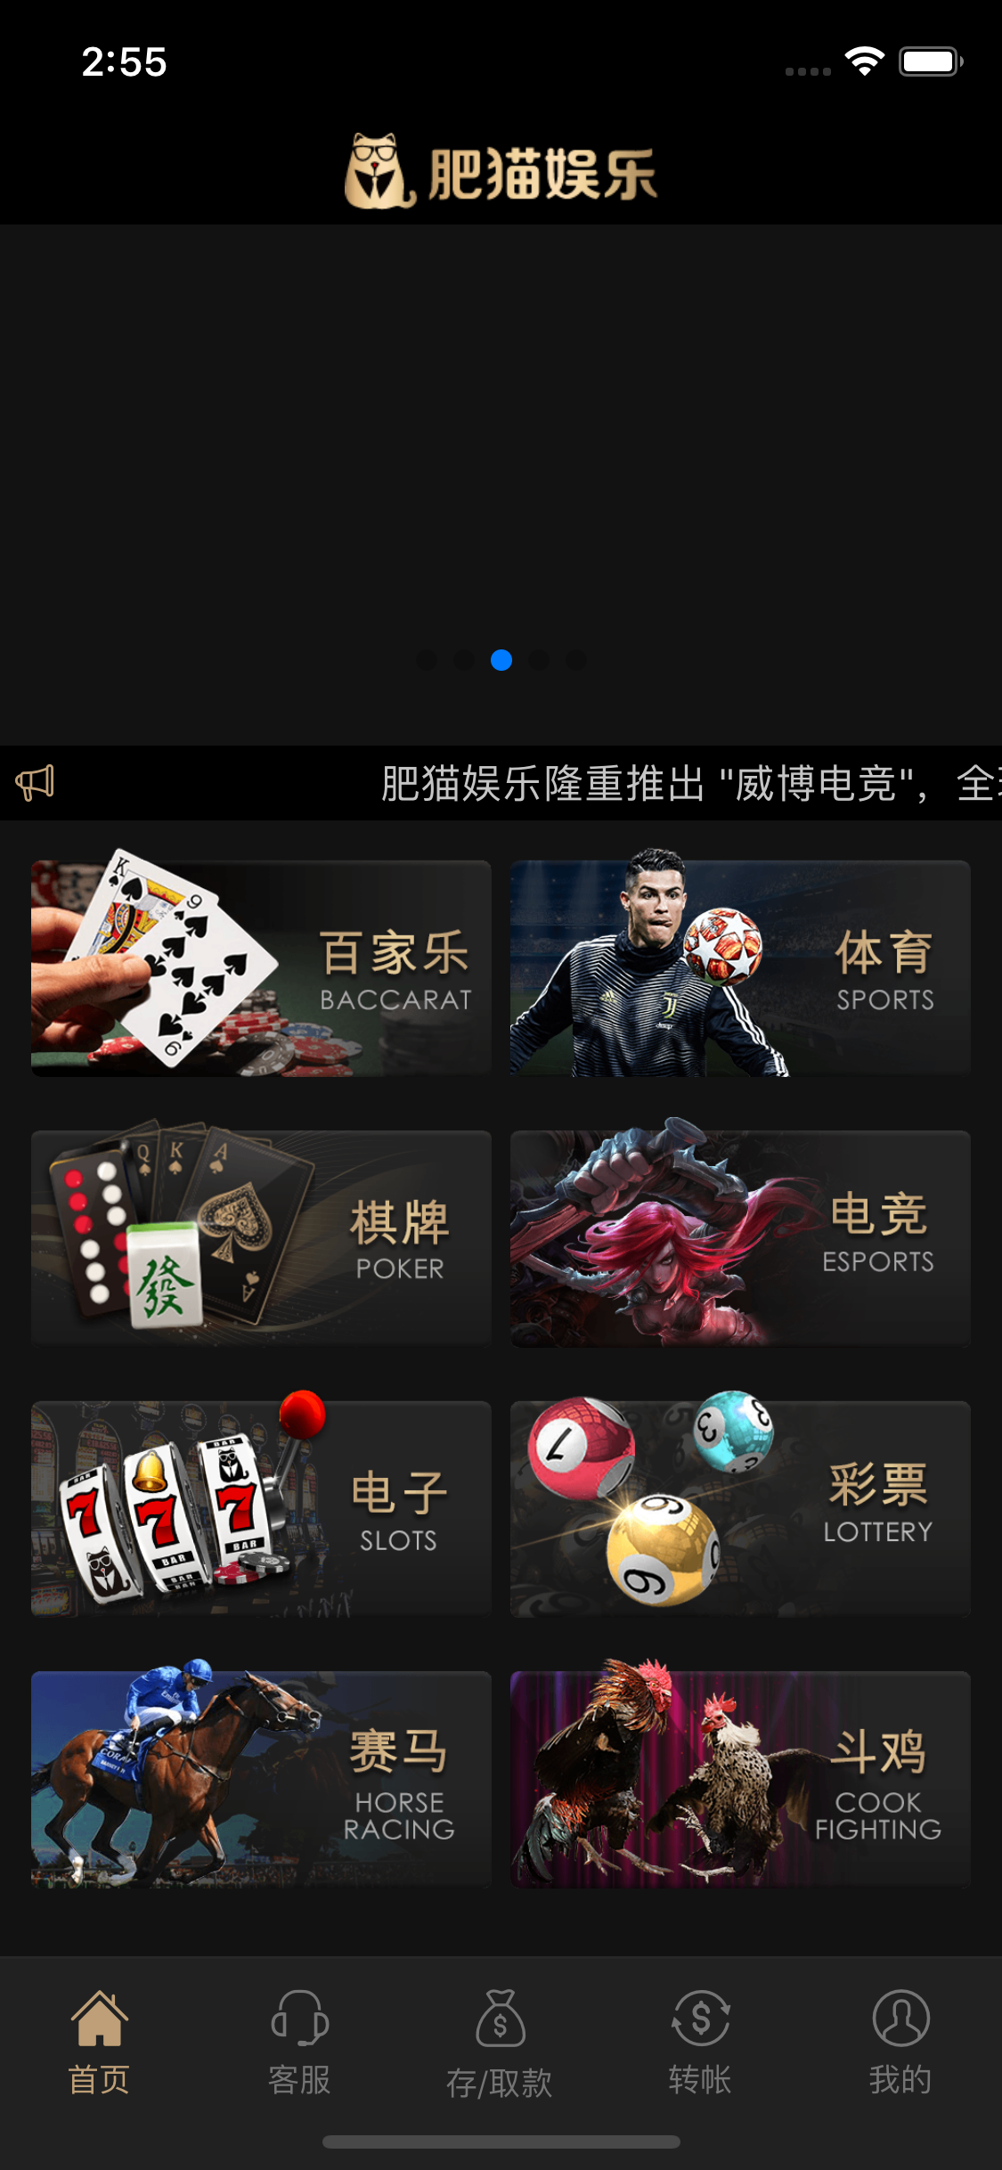
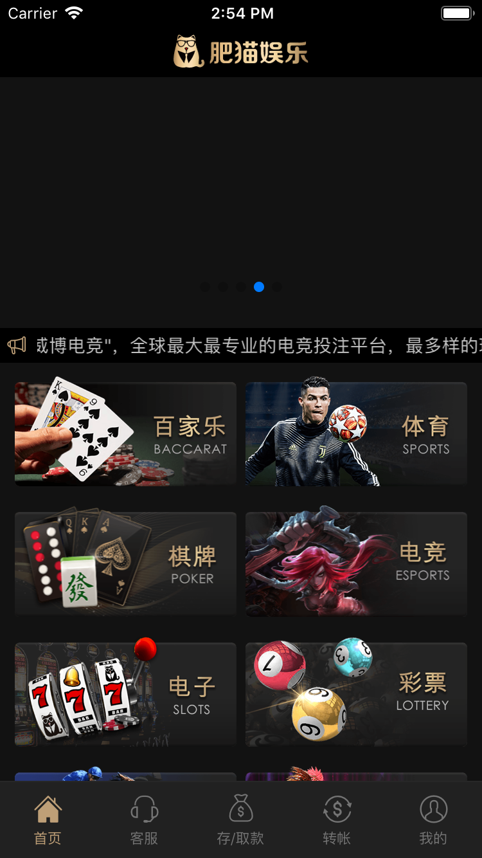
UI on Device

Slide 13
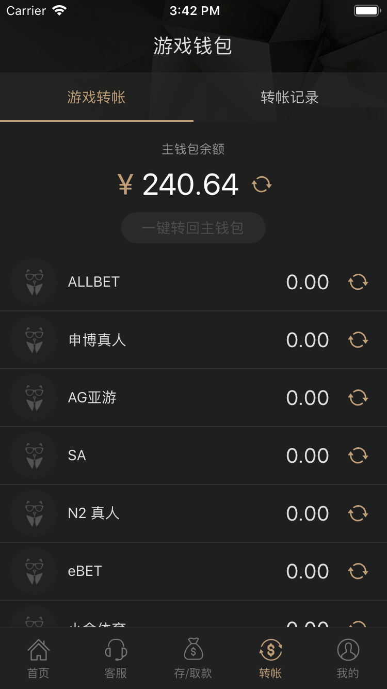
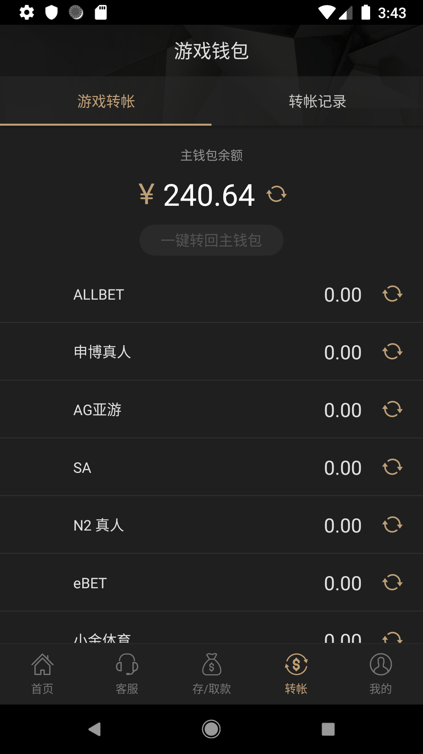
UI on Device

Slide 14
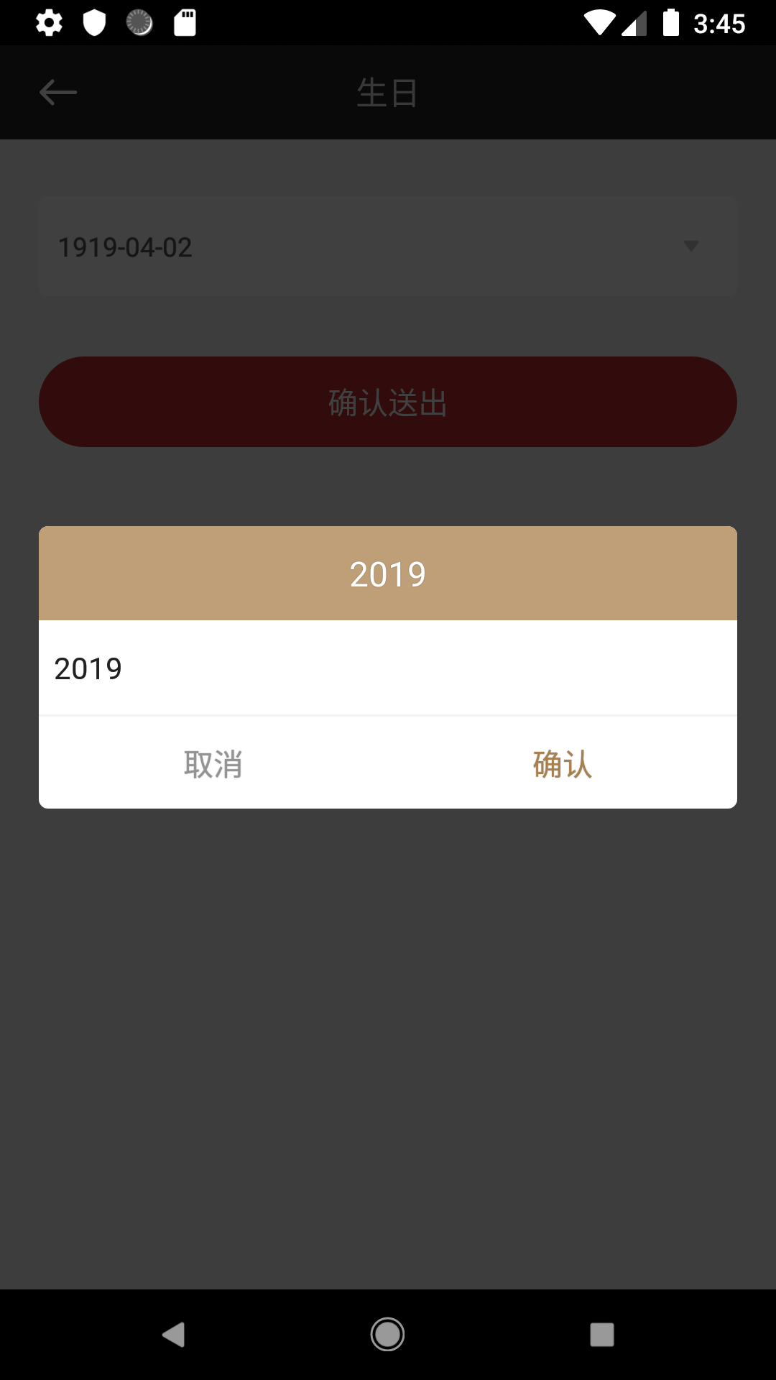
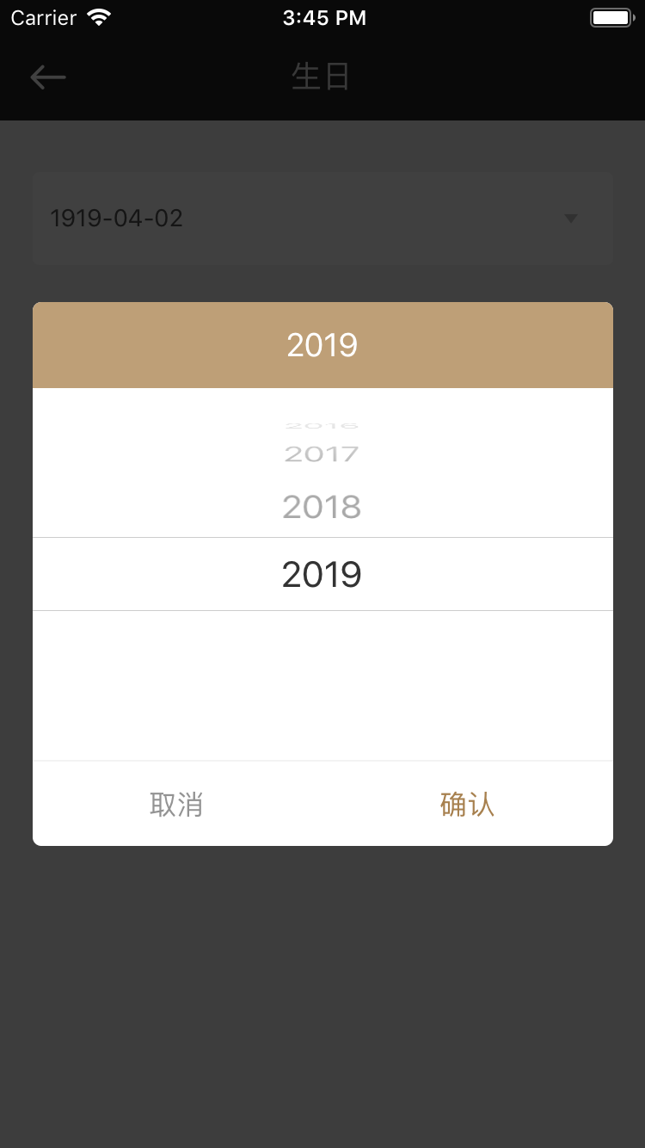
UI on Device

Slide 15
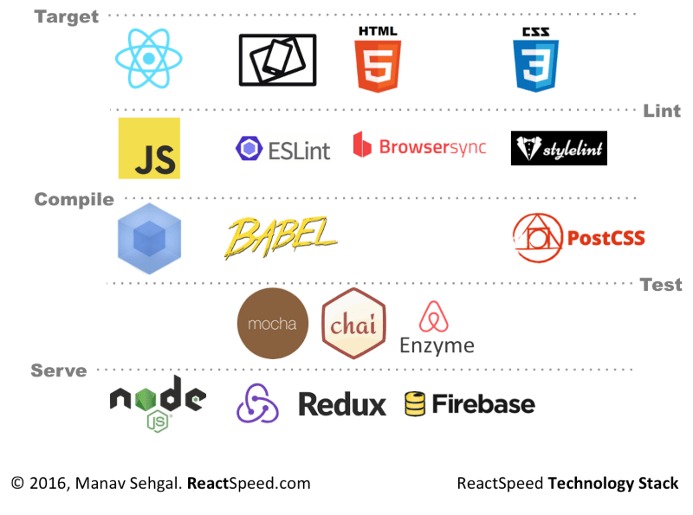
Conclusion

Slide 16

Conclusion

